Slide 1

BLOOD BANKING APPLICATION USING CLOUD COMPUTING
Submitted in the partial fulfillment for the award of the degree of
BACHELOR OF ENGINEERING
IN
COMPUTER SCIENCE – CLOUD COMPUTING
Submitted by:
SHIVANG – 20BCS4149
SREE VAGDEVI KANDUKURI - 20BCS4182

Slide 2

OUTLINE
ABSTRACT
INTRODUCTION
EXISTING SYSTEM
DRAWBACKS OF EXISTING SYSTEM
PROPOSED METHODOLOGY
RESULT
CONCLUSION
REFERENCES

Slide 3
ABSTRACT
The system will enable users to locate donors who have specific blood groups, permit new donors to register, and help patients to request blood.
Technologies have enhanced the efficiency and effectiveness of every aspect of the health industry, and information systems manage the distribution of blood through cloud computing.
In addition to educating the local community on the importance of blood donation, the website provides easy access to blood donation information, allowing hospitals in India to store and distribute blood.

Slide 4

INTRODUCTION
Our project is a response to the ongoing pandemic of COVID-19, where four potential challenges have aroused, due to the lockdown of transfusion services:
Lack of blood and its components
Donor and staff safety
Consumable supply and logistics
Catering to convalescent plasma needs
Our goal is to enhance the functionality of the system that stores, retrieves, and analyses information regarding administrative and inventory management.

Slide 5

The purpose of this study is to examine whether using online banking systems enhances blood transfusion safety as well as improves customer service. Therefore, the following specific issues are addressed in this study:
INTRODUCTION
1) What is the expected user base of the system? 2) What is the appropriate system architecture? 3) What is the extent to which the online bank management information system can boost blood quality transfusion safety? 4) Does the risk level of blood transfusion for manual blood transfusions and online blood banks differ significantly?

Slide 6
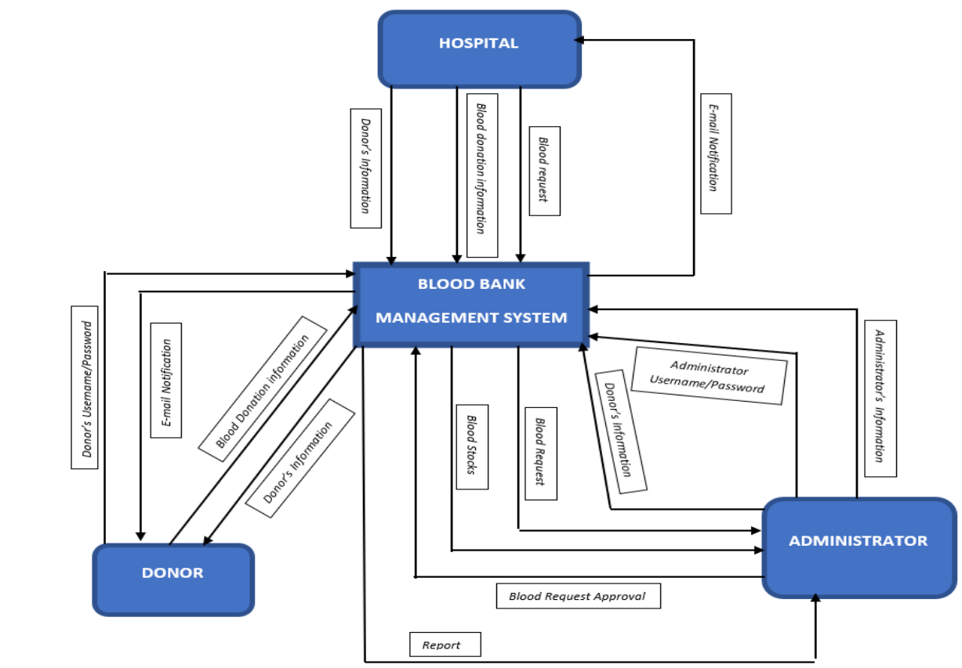
SYSTEM ARCHITECTURE

Slide 7
EXISTING SYSTEM AND ITS DRAWBACKS
In this study, we gathered and analysed data related to blood banks located in urban and rural areas. Few hospitals have blood banks with all the technical capabilities, but these facilities are insufficient for rural areas.
Cloud computing, health care, and social media have blended into several research programs.
DRAWBACKS:
Donors and blood banks do not have GPS coordinates.
Mobile applications are not available.
There is no link between hospital databases and the applications.
Management of data is time-consuming and clerical.
The availability of blood is limited in an emergency.

Slide 8


PROPOSED METHODOLOGY
Step 2 : Fill out the registration form to the request blood. All patient's data is stored in the database and reflected in the current requests.
Step 3: The admins track the location of the user if the blood is requested.
Step 4: Followed, the admin verifies if a nearby blood donor is available.
Step 1: Sign up as donor by filling out the form. In addition to saving the location of the donors to the database, the search donors feature also saves the same data.
Step 5: The admin accepts the donor, if he or she is eligible.

Slide 9
PROPOSED METHODOLOGY
Step 6: If the conditions are not satisfied, send the notification to other nearby donors if eligible.
Step 7: The donor’s and the requestor’s status is updated by the administrator.
Step 8: If the requested blood is unavailable, the administrator redirects the user to a list of blood banks.
Step 9: The admin notifies the user when the blood is available.
Step 10: Every time a request is made, the same process is followed.

Slide 10
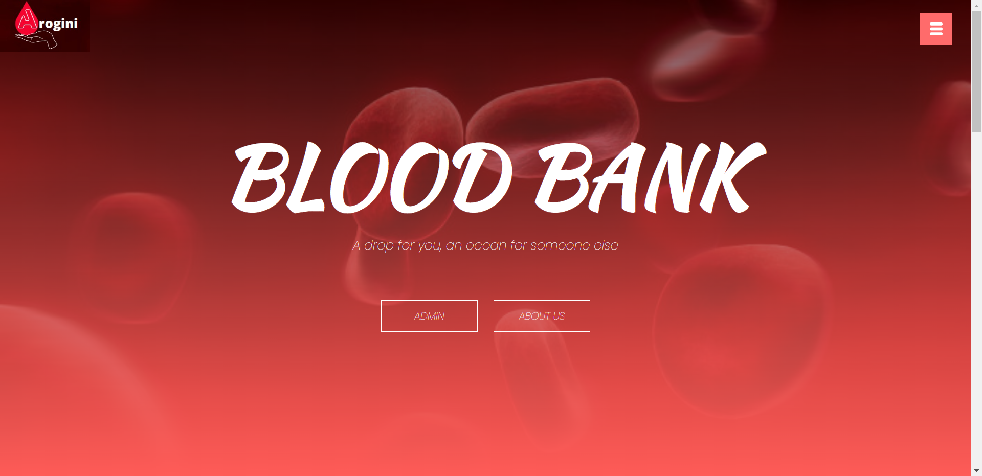
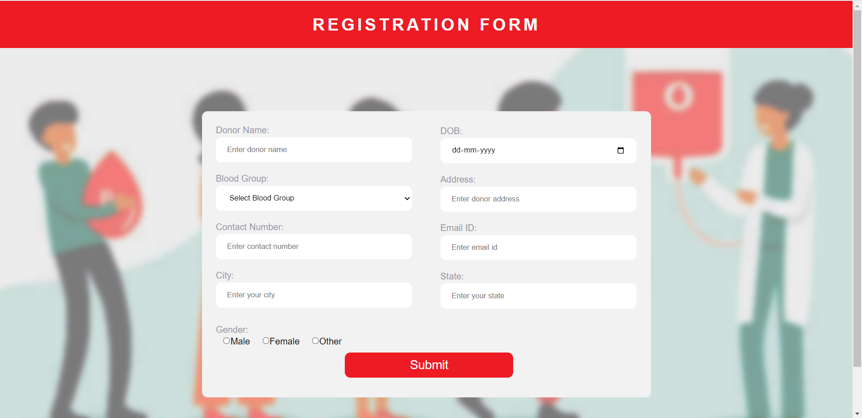
RESULT
HOME PAGE:
The website's home page is designed for admin, donor, and patient login.
The home page provides a navigation bar with multiple options and displays a dynamic record of donors and blood units in the blood bank.
To direct the users to different portals on the website, all the options for the user to perform particular tasks are provided on the main page.
BECOME A DONOR:
A donor can register to the system by providing the details asked.
A link will be automatically established between the module and the search donor module when the location shared by the donors is stored through API.
The search donors’ option will provide the requester with the designated place where they can search for nearby donors.

Slide 11
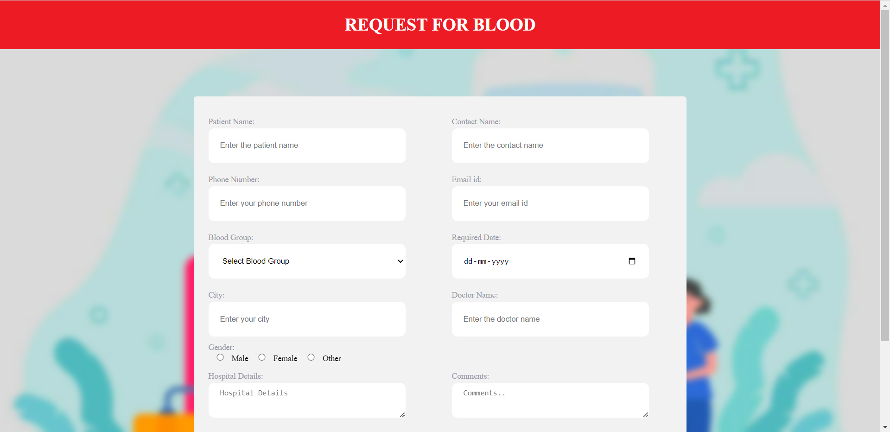
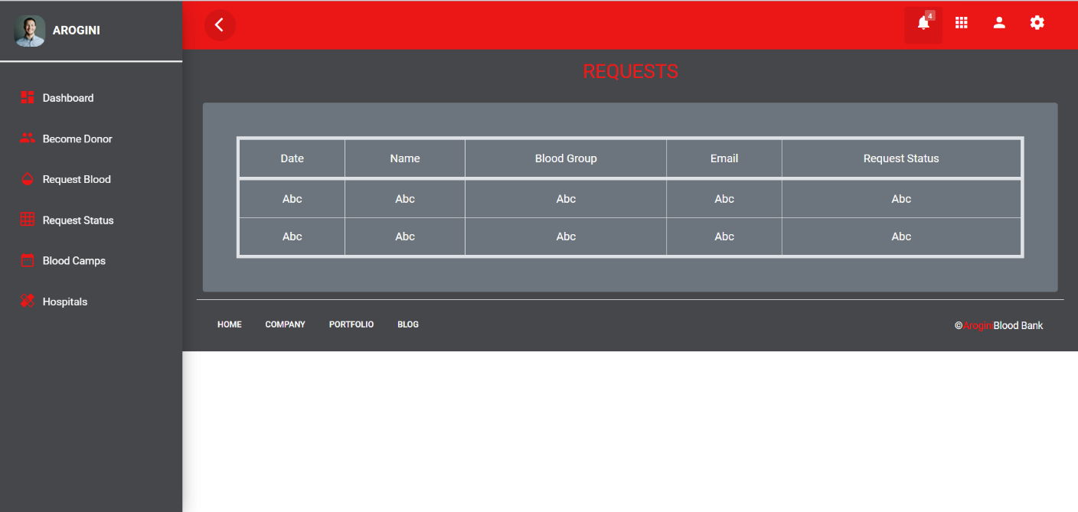
RESULT
REQUEST BLOOD:
The requestor has to provide the data asked as follows.
All the provided data is saved to the database, and the request is sent to the admin.
The system will now notify all selected donors and record the response.
CURRENT REQUEST:
All the provided data is saved to the database, and the request is sent to the admin.
The system will now notify all selected donors and record the response.

Slide 12
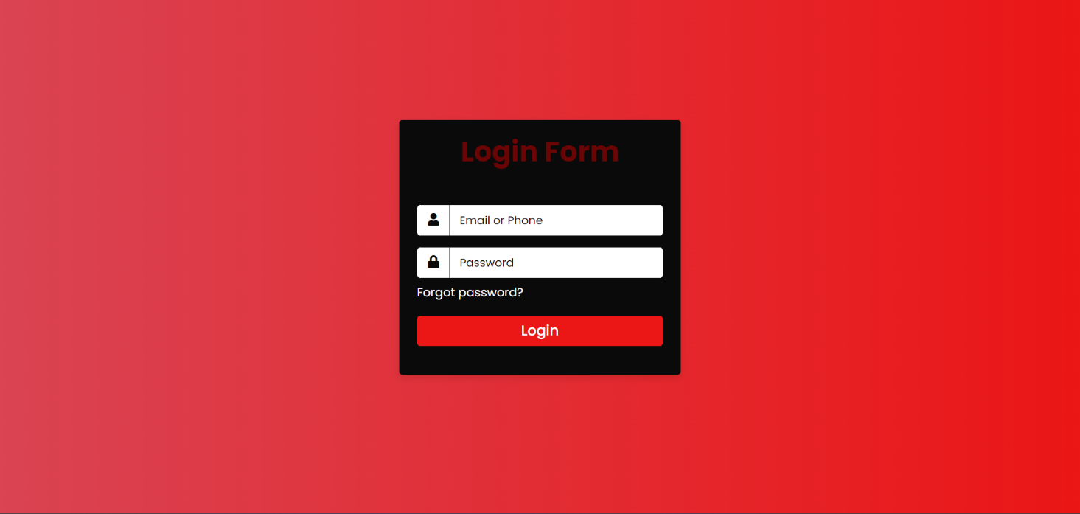
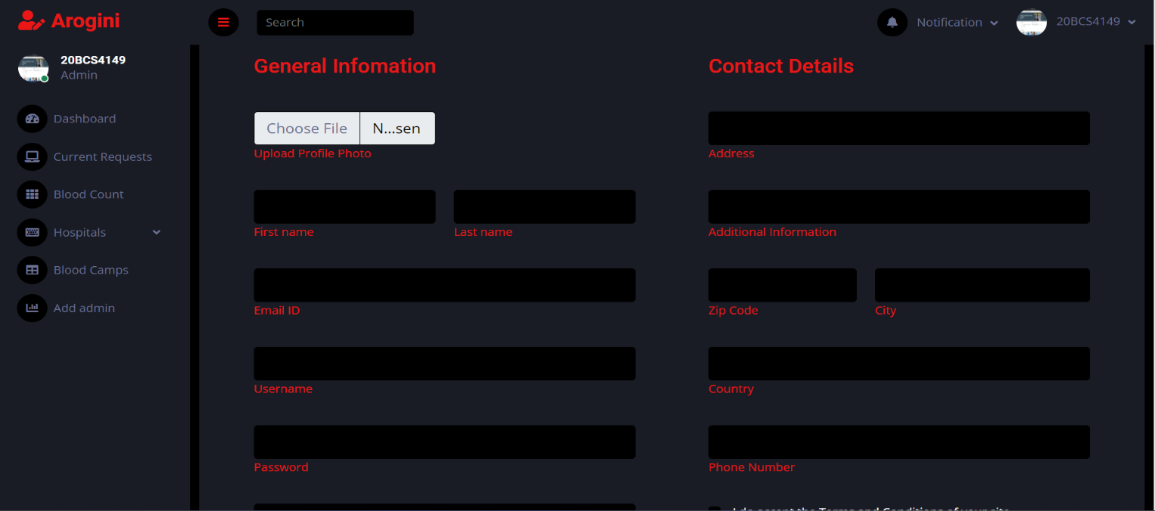
RESULT
ADMIN LOGIN:
The admin can login to the system and go through all the data being collected.
The collected data contains: the blood count, the current request, current donated blood and more.
ADD ADMIN:
All the new admins can be added by the main admin.
The new admins get registered under the main admin by providing the needed details.

Slide 13
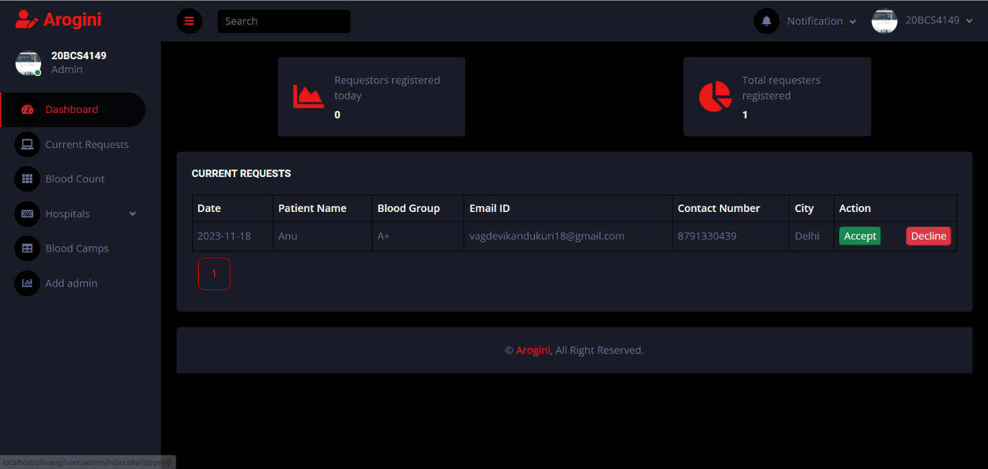
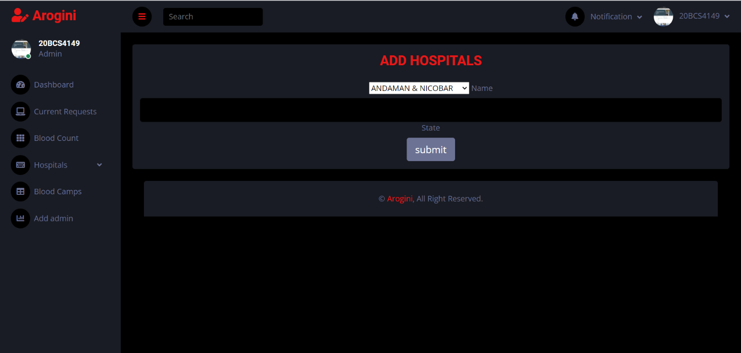
RESULT
CURRENT REQUEST – ADMIN SIDE:
The requested blood details are visible to the admin on their side.
All the provided data is saved to the database, and the request is sent to the admin.
The system will now notify all selected donors and record the response.
ADD HOSPITALS:
The admins can add new hospital details which are ready to collect blood.
The system will add all the details and reflect the same in the database.

Slide 14
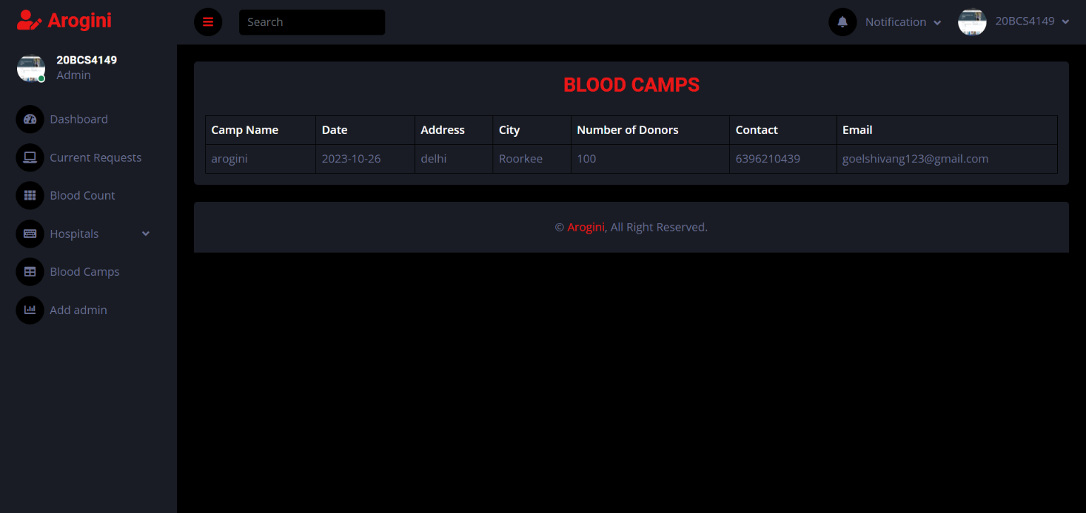
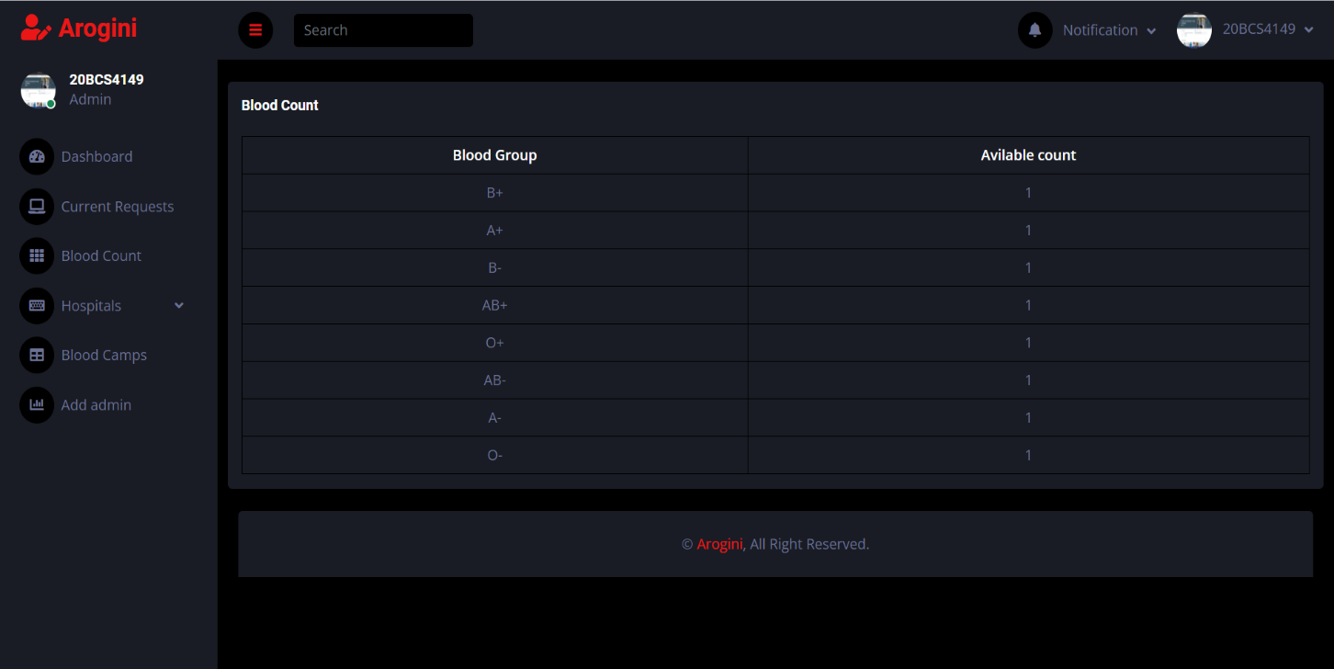
RESULT
BLOOD CAMPS:
The admin will be able to see the registered blood camps for the blood donation.
In case any user in organizing a blood camp they can register the same by logging in.
CURRENT BLOOD COUNT:
All the provided data is saved to the database, and the current blood count which is at present available is shown on the admin side and user side..
The system will now notify all selected donors and record the response, delete when blood is used.

Slide 15
CONCLUSION
Arogini blood banking management system is designed for helping people who require blood and for those willing to donate blood in an emergency.
The intention is to set up an online platform for matching mutually giving blood donors and patients who need blood.
Our focus is on creating an interactive donor, blood requester, and blood bank clinic experience.

Slide 16
REFERENCES
1. https://studylib.net/doc/25463289/research-paper-blood-bankmanagement-system
2. International Journal of Engineering and Advanced Technology (IJEAT) ISSN: 2249-8958 (Online), Volume-9 Issue-2, December, 2019 3246 Published By: Blue Eyes Intelligence Engineering & Sciences Publication Retrieval Number: B2850129219/2019©BEIESP DOI: 10.35940/ijeat.B2850.129219 Journal Website: www.ijeat.org E-Blood Bank Application using GPS and Cloud Computing
3. 2019 IEEE Bombay Section Signature Conference (IBSSC),Intelligent Blood Management System
4. International Research Journal of Engineering and Technology (IRJET) e-ISSN: 2395-0056 Volume: 05 Issue: 02 | Feb-2018 www.irjet.net p-ISSN: 2395-0072 © 2018, IRJET | Impact Factor value: 6.171 | ISO 9001:2008 Certified Journal | Page 278 E-Blood Bank Application Using Cloud Computing Shubham Pande1, Shweta Mate2, Pradnya Mawal3, Ayusha Jambulkar4, Prof. N. S. More5 1,2,3,4,5Department of Information Technology, Smt. Kashibai Navle College of Engineering ,India.
5. ICCOMSET 2018 IOP Conf. Series: Journal of Physics: Conf. Series 1179 (2019) 012028 IOP Publishing doi:10.1088/1742- 6596/1179/1/012028 1 Blood Bank Information System Based on Cloud Computing In Indonesia Muhammad Nur Sahid Ramadhan1*, Arinda Amyus 1 , Ahmad Nurul Fajar1 , Sfenrianto Sfenrianto1 , Abiyyu Fawwaz Kanz1 , Moh Sukron Mufaqih1 1 Information Systems Management Department, BINUS Graduate Program – Master of Information Systems Management, Universitas Bina Nusantara, Jakarta, Indonesia
6. A Research Paper on Blood Donation Management System 1Devanjan K. Srivastava, 2Utkarsh Tanwar, 3M.G.Krishna Rao, 4Priya Manohar, 5Balraj Singh 1234Student, Computer Science Engineering, 5Assistant Professor, School of Computer Science Engineering 12345Lovely Professional University, Jalandhar, India
7. International Journal of Applied Engineering Research ISSN 0973- 4562 Volume 15, Number 6 (2020) pp. 609-611 © Research India Publications. http://www.ripublication.com 609 Cloud Computing Based Framework for Blood Services Albert Kurian1 , Basil Joseph Benny2 , Adharsh Raju3 , Joby P P4 1,2,3 B.Tech Student, 4. Professor, St. Josephs college of Engineering and Technology, Palai
8. American Red Cross Blood Services - https://www.redcrossblood.org/ [6] Blood Bank India
9. https://www.bloodbankindia.net/ [7] e-Rakt Kosh
10. https://www.eraktkosh.in
11. https://cdsco.gov.in/opencms/resources/UploadCDSCOWeb/ 2018/UploadBloodBank/newBLOOD_BANKS_INDIA.pdf

Slide 17

THANK YOU

